Slide 1
Sales Automobile using Salesforce CRM

Slide 2
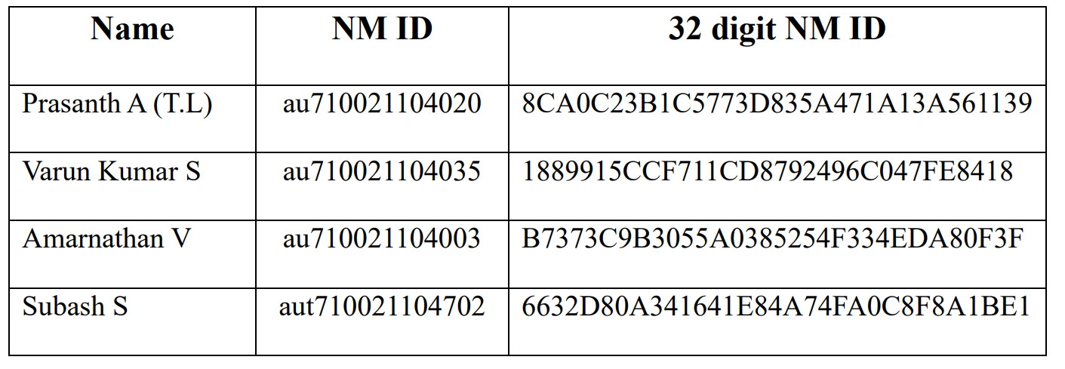
Team

Slide 3

Project Overview
This project focuses on developing a Salesforce CRM solution tailored to streamline and automate the automobile sales process. It addresses the challenges of,
managing vast amounts of sales data,
maintaining accurate inventory records, and
automating routine business processes in the automobile industry.
The primary goal is to implement a solution that utilizes Salesforce’s robust features, such as custom objects, Apex automation, and Lightning Web Components (LWC), to improve sales management.
Align with the broader objectives of the organization, ensuring better tracking of customer interactions and quicker sales cycle times.

Slide 4
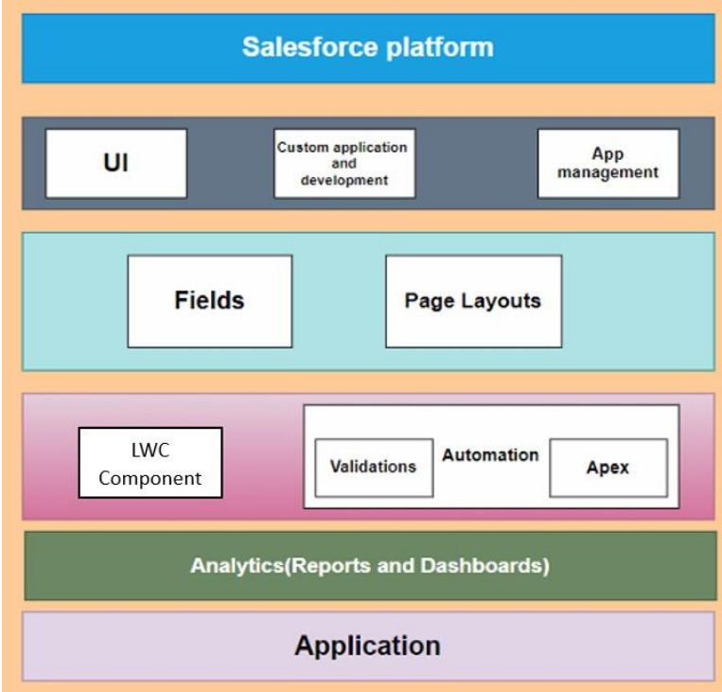
Technical Architecture

Slide 5
Objectives
Business Goals
Specific Outcomes
Improve the efficiency of sales management in the automobile industry.
Automate key business processes to save time and minimize errors.
Provide actionable insights into sales performance and inventory tracking.
Creation of custom Salesforce objects for automobile information, invoices, and opportunities.
Implementation of Apex triggers for advanced automation.
Development of a Lightning Web Component (LWC) to display real-time invoices.
Integration of Salesforce reports and dashboards for detailed analytics.

Slide 6
Our goals
Short term
Long term
Our main goals now are to increase sales through improved marketing and customer outreach, optimize operational processes to reduce costs and increase efficiency and establish a timeline for new products
The overall goal of the company is to expand into new markets or geographies, develop and implement a strategy to reduce environmental impact and increase sustainability and increase market share

Slide 7
Project Flow
Salesfoce
Object
Tabs
Lightning App
Apex Triggers
Page Layouts
LWC Component
Fields & relationships
Apex Scheduler
Reports
Dashboard

Slide 8
Key Features and Concepts
Custom Objects:
Relationships:
Opportunity Automobile, Automobile Information, and Invoice.
Master-detail and lookup relationships for efficient data linking.
Apex Triggers:
Lightning Web Components (LWC):
Automation for tasks like invoice creation and quantity validation.
Real-time display of invoice data.
Reports and Dashboards:
Visualization of sales performance and inventory data.

Slide 9
Solution Design Steps
Data Model
User Interface
Business Logic
Custom objects like Opportunity Automobile and Invoice were designed to store specific data.
Fields and relationships were created to enable seamless integration between objects.
Custom tabs and page layouts were created for easy navigation.
A Lightning App was configured to group related functionalities for better user accessibility.
Apex triggers were implemented to automate invoice generation, validate stock availability, and manage opportunities.
A Lightning Web Component was created to display invoices linked to specific opportunities.

Slide 10
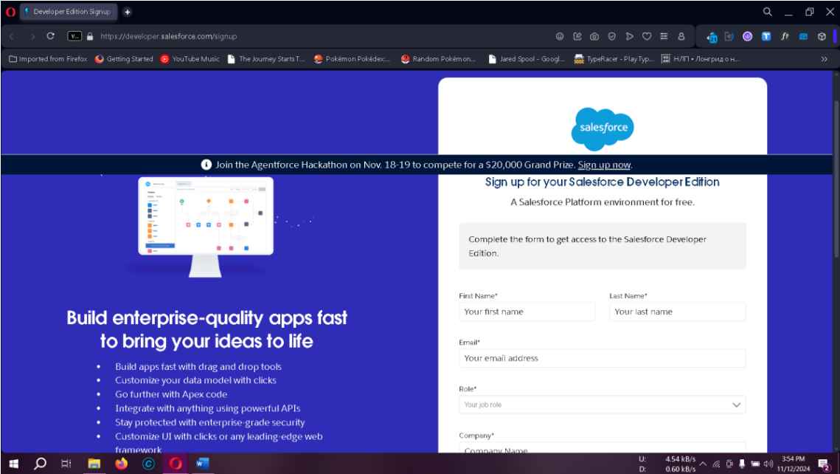
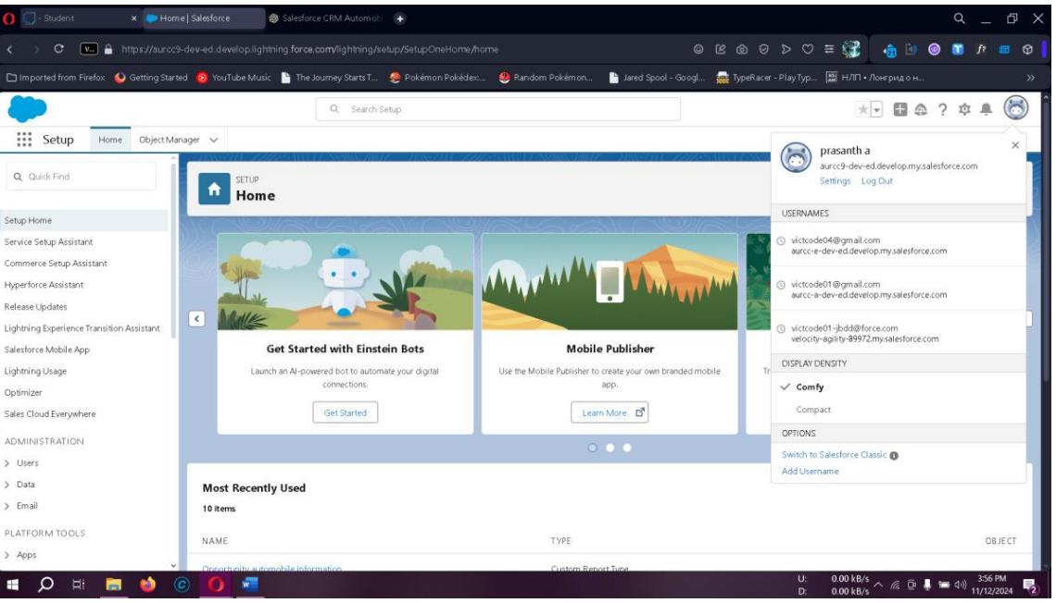
Developer Account Creation
Creating a Salesforce developer account provides access to CRM features and customization tools necessary for the setup.
Sign-Up: Complete the Salesforce Developer Sign-Up with details such as name, email, role, and company.
Account Activation: Verify via email, set up a password, and access the Salesforce setup.

Slide 11
Creating Objects in Salesforce
Objects are tables within Salesforce for data storage:
Standard Objects: Default Salesforce objects (e.g., Accounts, Contacts).
Custom Objects: User-defined objects for specialized data, like Automobile Information and Invoice.

Slide 12
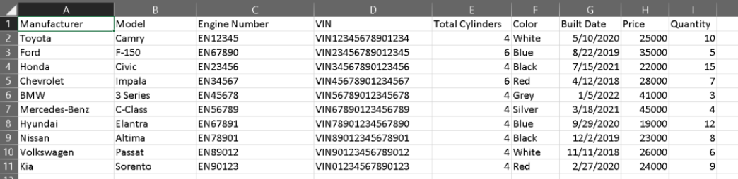
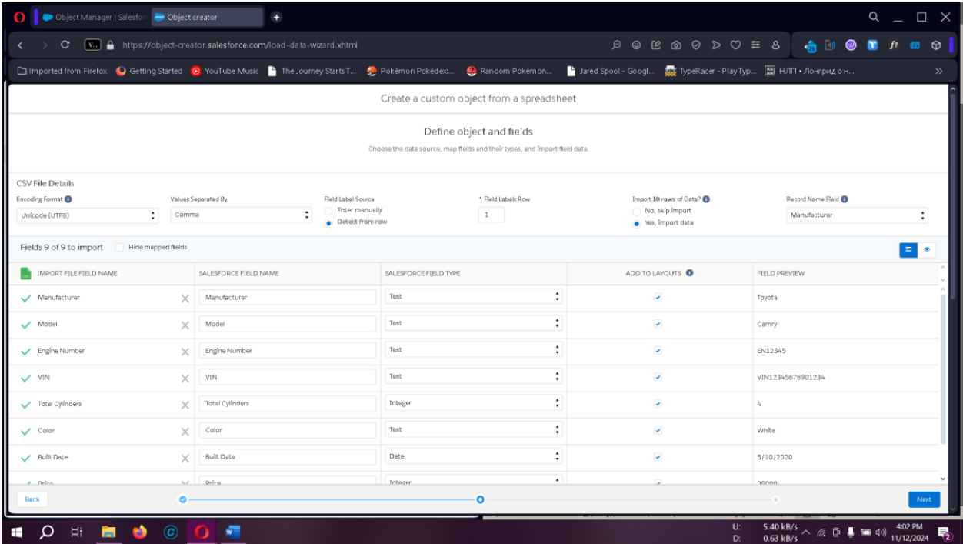
Automobile Information: Upload from AutomobileInformation.csv in Setup > Object Manager.

Slide 13
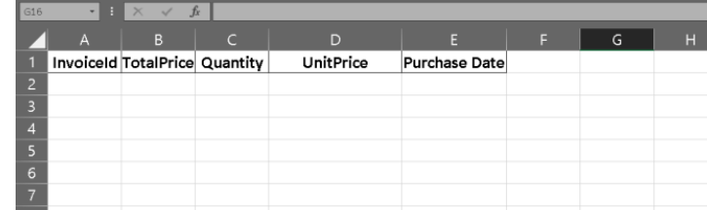
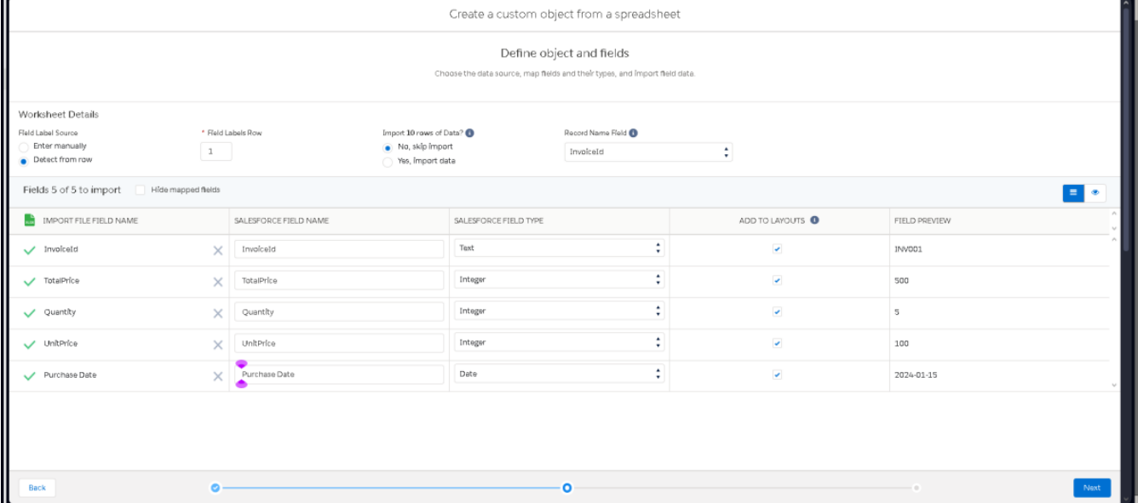
Invoice Object: Use similar steps to import data from the Invoice CSV file.

Slide 14
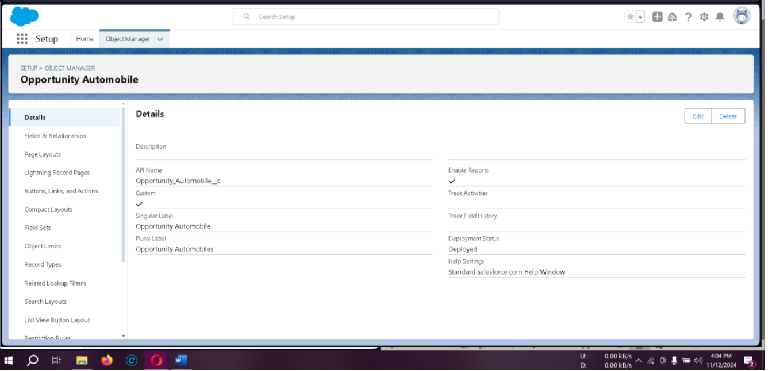
Opportunity Automobile Object: Create manually with fields such as Quantity, Unit Price, and Total Price.

Slide 15
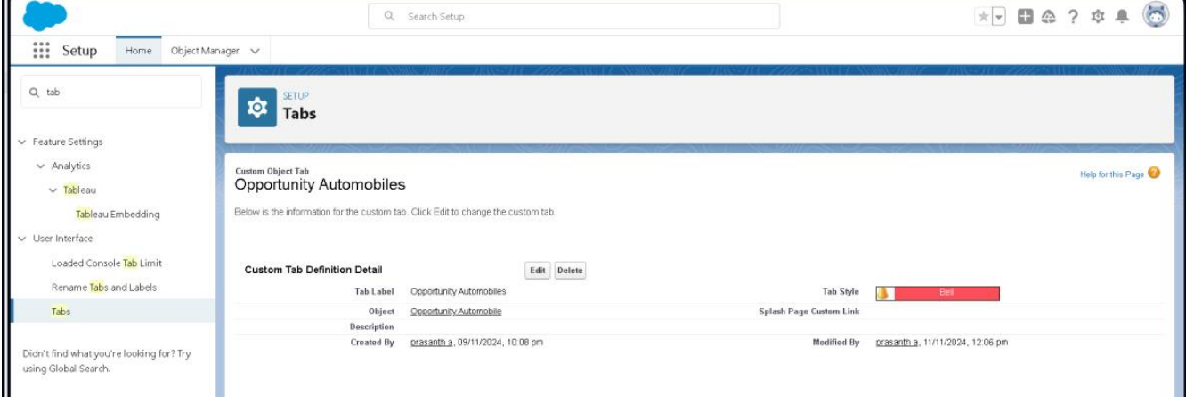
Tabs in Salesforce
Tabs offer an interface for accessing custom objects:
Types of Tabs: Include Custom Tabs, Web Tabs, Visualforce Tabs, etc.
Creating a Custom Tab: Add a tab for Opportunity Automobile via Setup > Tabs.

Slide 16
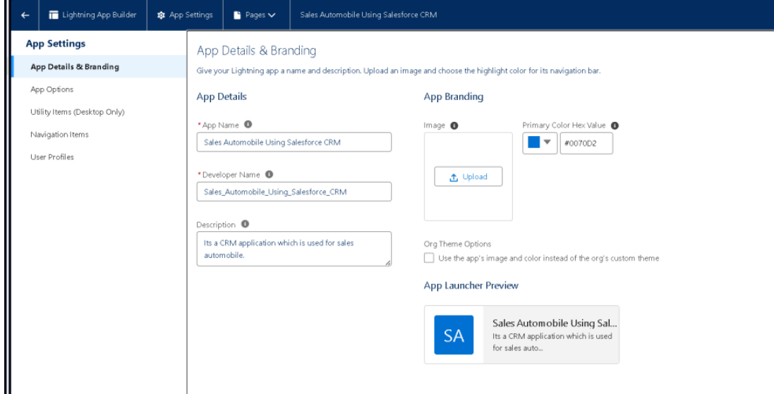
The Lightning App
Create a Lightning App to group all related items:
From Setup > App Manager, create a new Lightning App, name it, and assign tabs for easy navigation.

Slide 17
Fields & Relationships
Define custom fields and establish relationships to store structured data and link objects.
Field Creation: Add fields like Quantity and Unit Price to calculate totals.
Master-Detail and Lookup Relationships: Link objects like Opportunity Automobile to Opportunity and Automobile Information.

Slide 18
Fields & Relationships
1. | Creating Master Detail Relationship in Opportunity Automobile | Data type : Master-Detail Relationship Link to the Opportunity object for data hierarchy
2. | Creating Lookup Field for Automobile | Use Lookup Relationship to connect Automobile Information to Opportunity Automobile.
3. | Creating Quantity Number Field in Opportunity Automobile Object | Data type : Number Field Name : Quantity mark it as Required.
4. | Create a formula field in the Opportunity Automobile object | Data Type: Formula Field Name : Unit Price Formula return type : Currency (set decimal places to two) Automobile__r.Price__c in Advanced Formula (Check Syntax)
5. | Create a formula field in the Opportunity Automobile object: | Data Type: Formula Field Name : Total Price Formula return type : Currency (set decimal places to two) Unit_Price__c * Quantity__c in Advanced Formula (Check Syntax)
6. | Creating Master-Detail Relationship Field in the Invoice Object | field name : Opportunity data type : Master-Detail Relationship

Slide 19
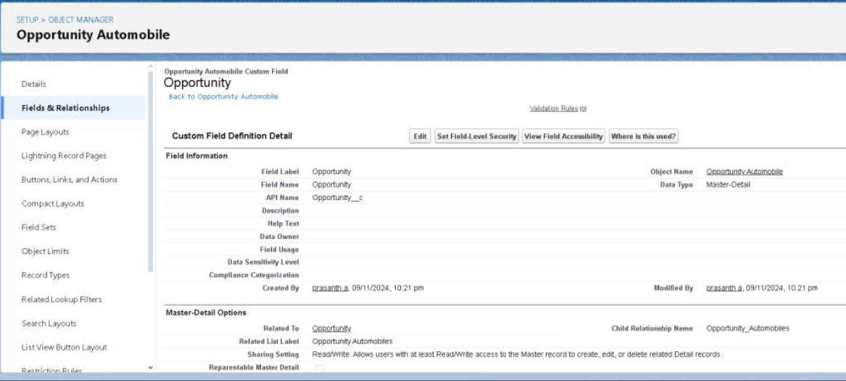
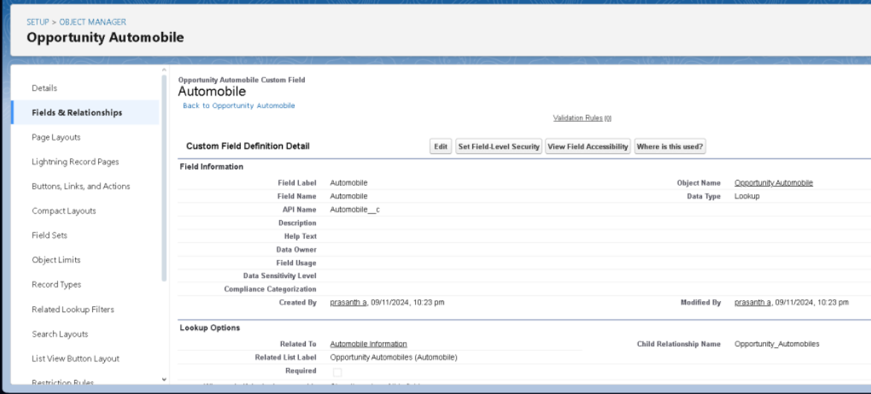

Slide 20
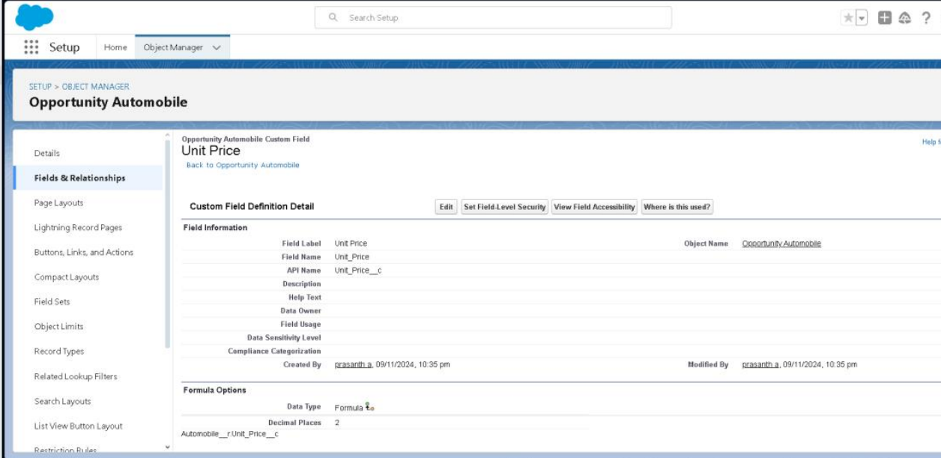
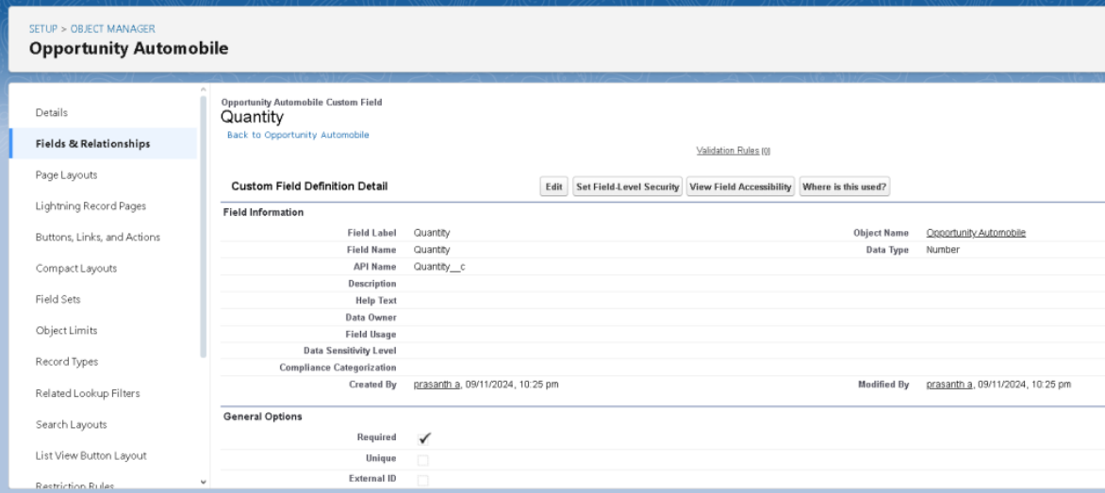

Slide 21
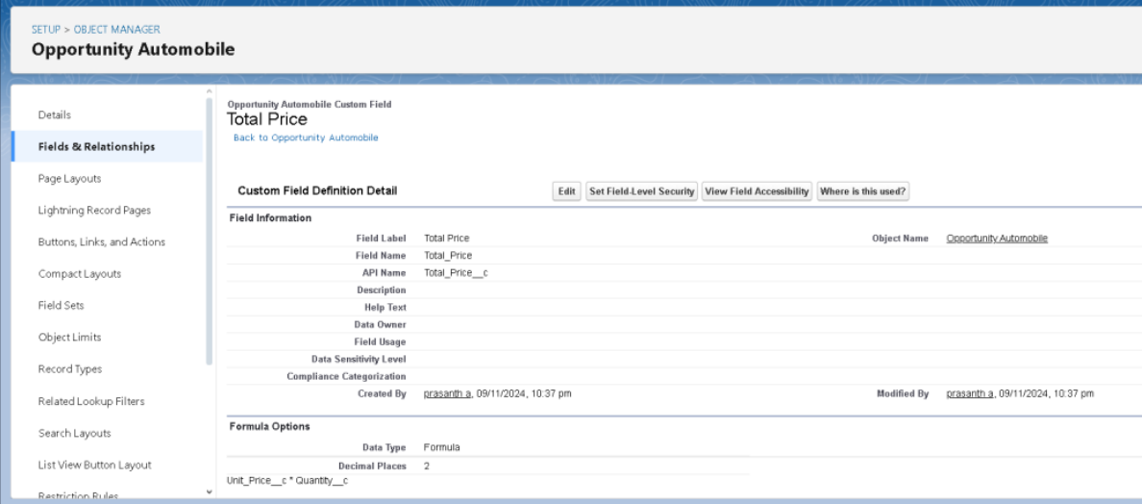
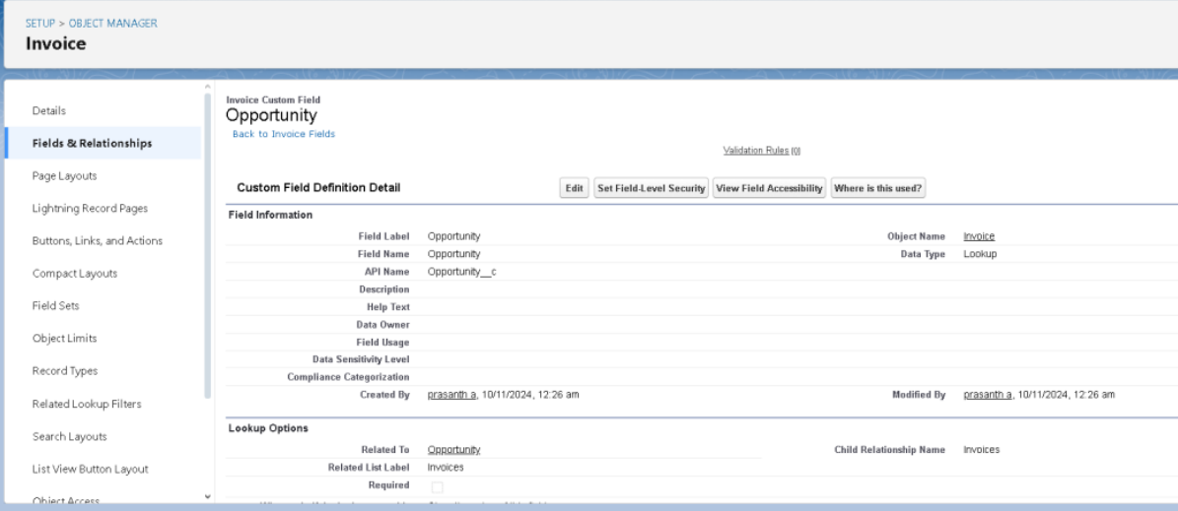

Slide 22
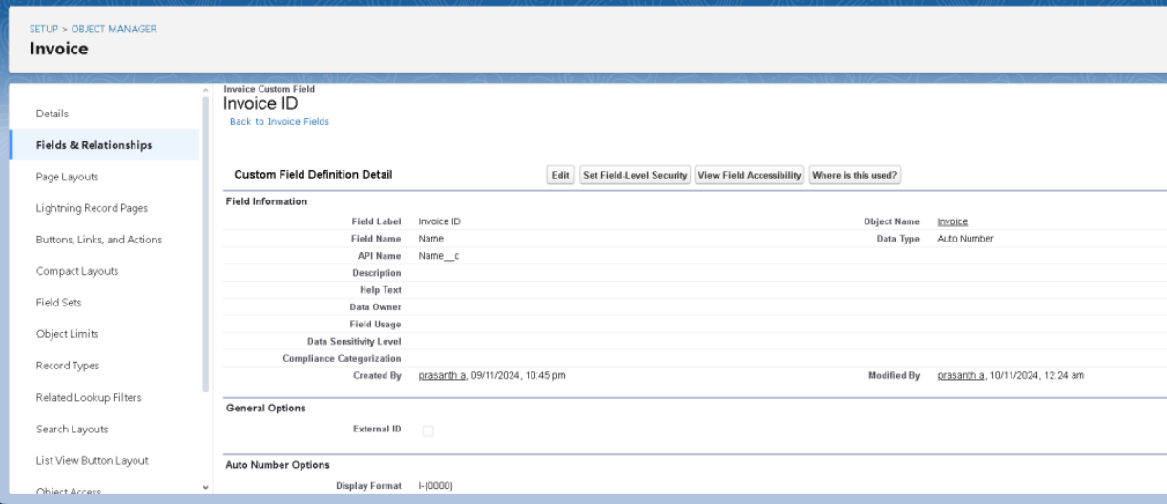
Updating Fields
Set fields like Invoice ID as Auto Number for streamlined tracking display format (e.g., I-{0000}).

Slide 23
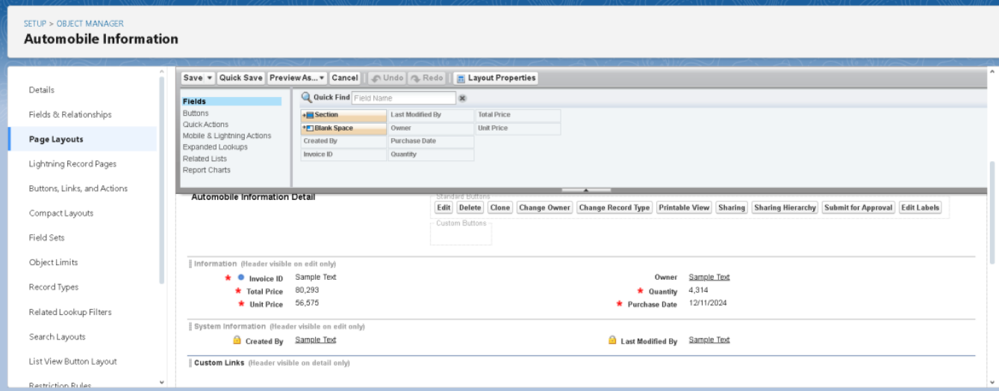
Page Layouts and Customization
Organize fields on Opportunity and Automobile Information pages for clear data display.
Access via Setup > Object Manager and arrange fields for enhanced usability.

Slide 24
Advanced Automation with Apex Triggers
Apex Triggers automate actions based on changes to records.
Use Case 1: Updating Automobile Quantity upon Opportunity Closure
Objective: Reduce stock when an opportunity is won.
Implementation:
Trigger: Monitors Opportunity stage changes.
Class: Updates Automobile Information records upon stage change to "Closed Won".
Use Case 2: Validating Automobile Quantity Availability
Objective: Prevent overselling by checking stock.
Implementation:
Trigger: Fires when an Opportunity is created or edited.
Class: Validates requested quantity against available stock.

Slide 25
Use Case 3: Invoice Creation upon Opportunity Closure
Objective: Automate invoice generation for closed-won opportunities.
Implementation:
Trigger: Monitors Opportunity stage changes.
Class: Creates invoices based on Opportunity data when the stage is "Closed Won".
Use Case 4: Ensuring Contact Role is Assigned
Objective: Prevent closing opportunities without assigned contacts.
Implementation:
Trigger: Monitors Opportunity stage changes.
Class: Verifies contact role assignment before allowing closure.

Slide 26
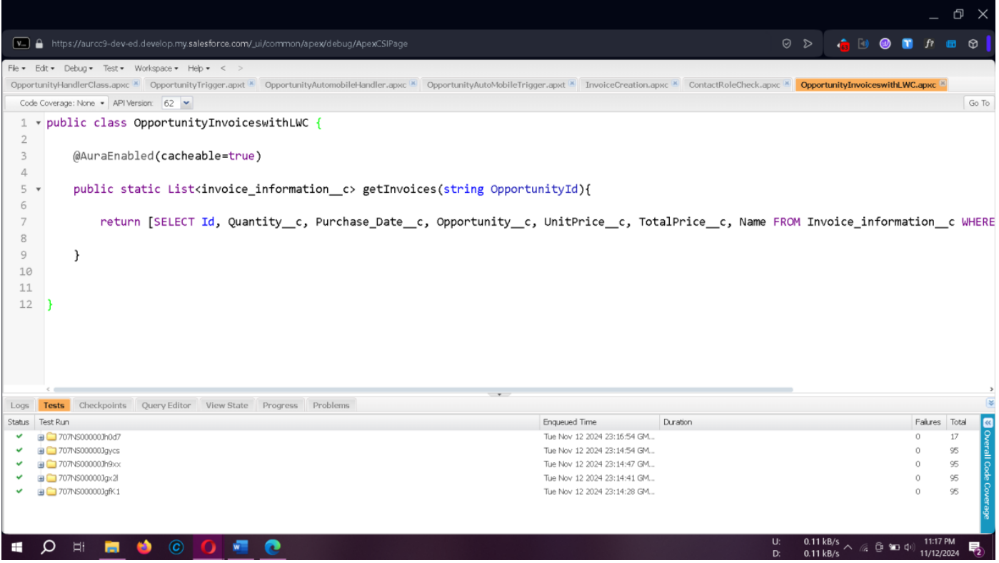
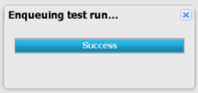

Slide 27
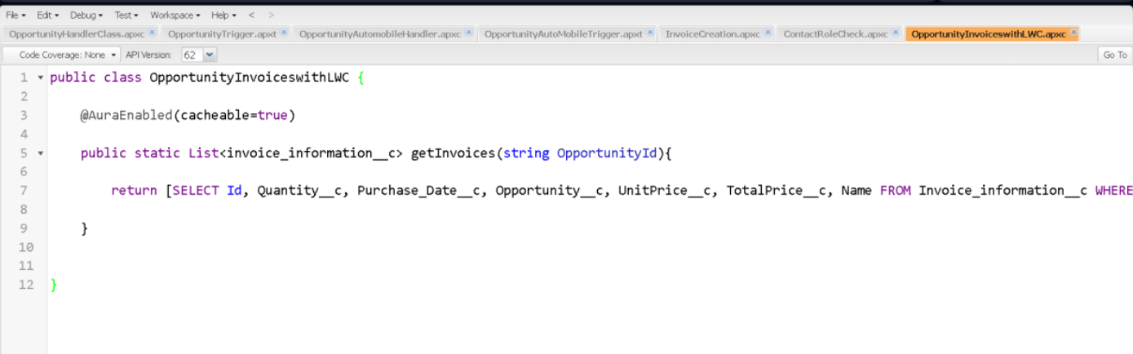
LWC Components for Invoices
Objective: Create an LWC to display Opportunity invoices using an Apex class.
1. Apex Class: Retrieve invoices linked to an Opportunity.
2. LWC Component: Displays invoices on the Opportunity page.

Slide 28
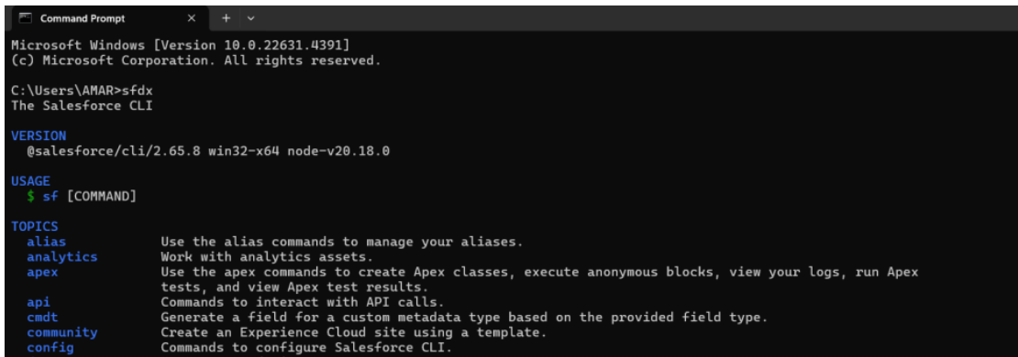
Setting Up the Salesforce CLI
Download and Install
The Salesforce CLI is essential for streamlining development. Download and install it, and verify the installation by typing sfdx in your command prompt.

Slide 29
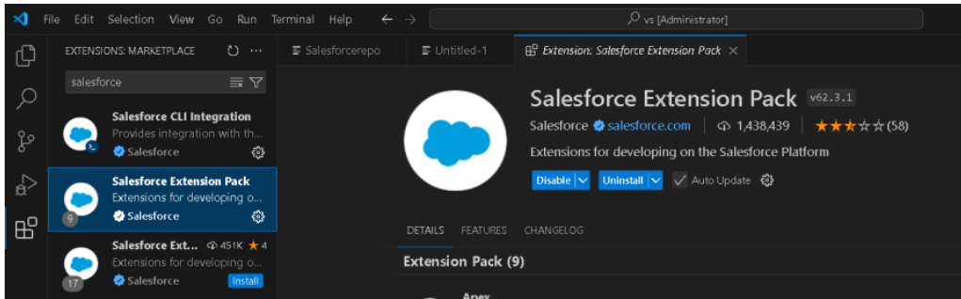
Creating a Salesforce Project in Microsoft Visual Studio Code (VS Code)
1. Download and Install VS Code Ensure you download the version compatible with your operating system.
2. Install the Salesforce Extension Pack Open VS Code, go to Extensions, and search for Salesforce Extension Pack. Click Install
3. Create Project and Update your package.xml file with the following code to work with LWC components.
4. Authorize an Org Establish a connection with your Salesforce org by pressing CTRL + SHIFT + P, typing sfdx: authorize an org, and selecting Production for the developer edition

Slide 30
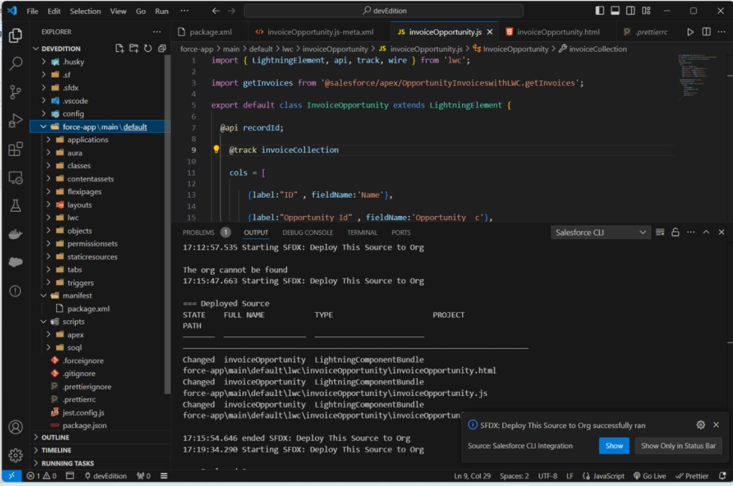
Creating a Salesforce Project in Microsoft Visual Studio Code (VS Code)
Creating the Lightning Web Component
create lightning web component, and name it InvoiceOpportunity.
Deploy Component by select SFDX: Deploy Source to Org

Slide 31
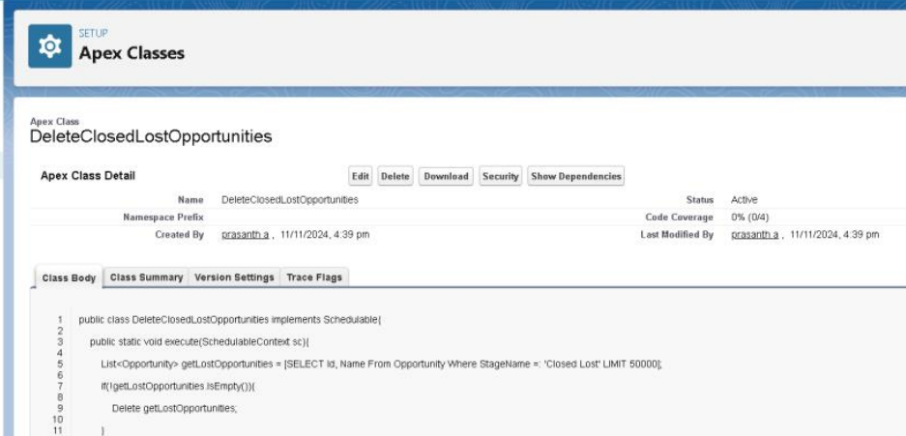
Automating Periodic Actions with Scheduled Apex
Create Apex Class for Scheduler In Developer Console, create a new Apex class called DeleteClosedLostOpportunities.
Schedule the class and set it to run every Monday at 10:00 AM.

Slide 32
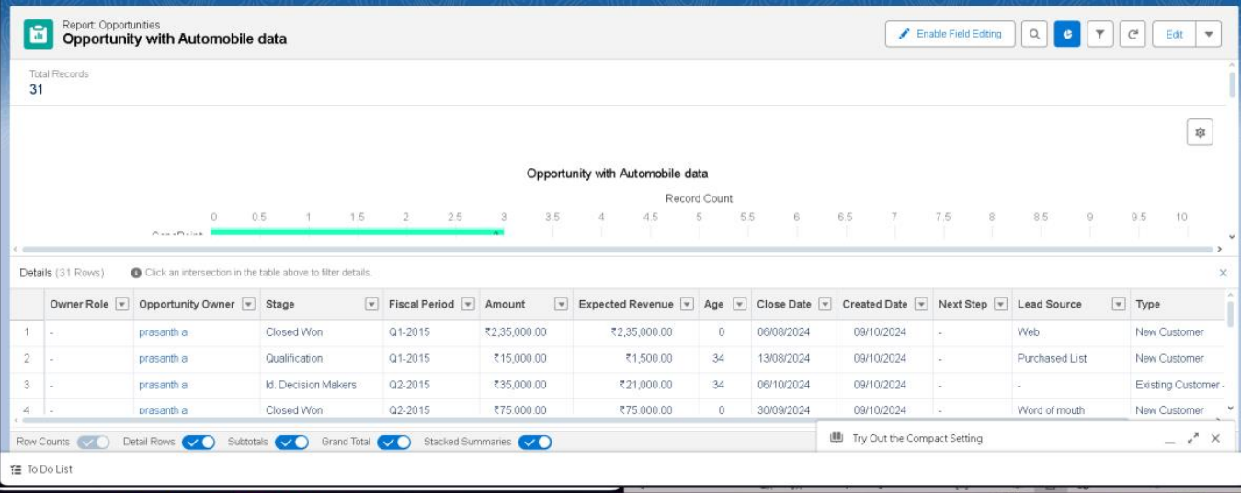
Reports
Opportunity Sales Report: Generate using Reports for key sales metrics.
Create a Report on Automobile Information:

Slide 33
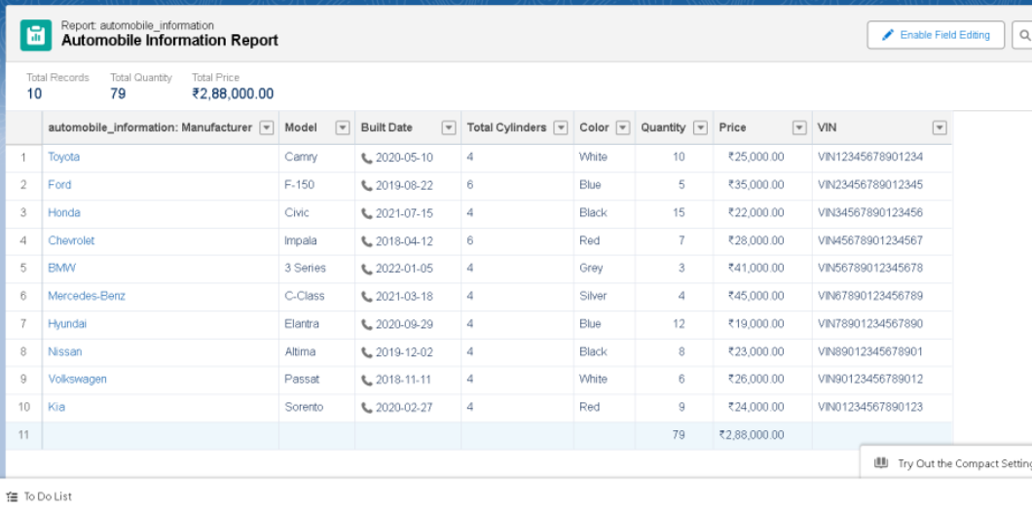
Reports
Create a Report on Opportunity Automobiles:

Slide 34
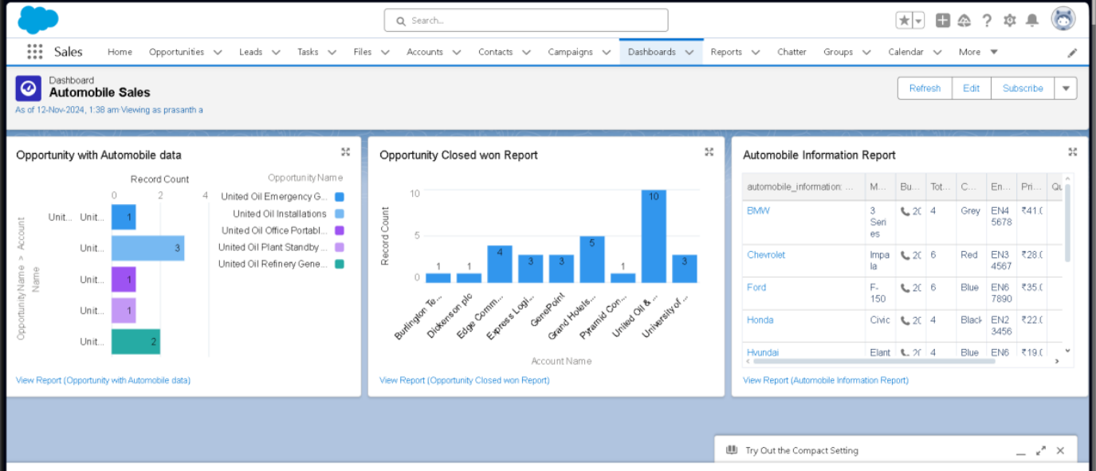
Dashboards
Automobile Sales Dashboard: Summarize and visualize sales data trends.

Slide 35
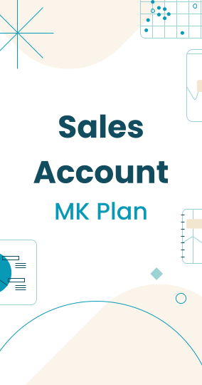
Key Scenarios Addressed by Salesforce in the Implementation Project
01.
02.
Inventory Management: Tracks automobile stock levels and updates automatically when sales are completed.
Sales Automation: Automatically generates invoices and updates opportunities when marked as closed won.
Performance Insights: Provides detailed reports and dashboards for monitoring sales trends and team performance.
Data Validation: Ensures that users cannot overbook inventory or skip mandatory fields.
Sale automobile using CRM
03.
04.

Slide 36
Thank you

